Slide 1

MAULANA AZAD NATIONAL INSTITUTE OF TECHNOLOGY,BHOPAL
MINOR PROJECT PRESENTATION
HIT SONG PREDICTOR
SUBMITTED BY:
VIVEK JAIN 171112305 SIDDHARTH MORE 171112218
ARSUDE AKASH NAGNATH 171112290 PRANSHU KUMAR 171112297
UNDER THE GUIDANCE OF
DR. PRAVEEN KAUSHIK

Slide 2
Contents:
Introduction
Problem Definition
Proposed Work
Methodology
Results
Conclusion and Future Work
References

Slide 3
INTRODUCTION
The Billboard Hot 100 Chart remains one of the definitive ways to measure the success of a popular song. The Billboard Hot 100 is the music industry standard record chart in the United States for songs, published weekly by Billboard magazine
We have used machine learning techniques to predict whether or not a song will become a Billboard Hot 100 hit, based on its audio features. The input to each algorithm is a series of audio features of a track.
Not only will it help determine how to produce songs to maximize their potential for becoming a hit, it could also help decide which songs could give the greatest return for investment on advertising and publicity.
Furthermore, it would help artists and music labels determine which songs are unlikely to become Billboard Hot 100 hits.

Slide 4
^{PROBLEM DEFINITION}
Predict whether a song will be a Billboard Hot 100 hit or not based on its audio features.
In the world of entertainment where every day new songs are released, artists or people may be interested to know whether the song they are producing or listening to will be a hit song or not.
Compare the results obtained after applying different classification algorithms.

Slide 5
PROPOSED WORK
Compiling Datasets - Billboard Hot 100 songs are scrapped from Wikipedia.
A dataset of songs is taken from Kaggle containing mostly non hit songs.
The audio features of the Songs are obtained from Spotify API.
Python has a light Weight library called Spotipy which provides an access
to Spotify Web API.
The Audio feature provided by Spotify which we have used for our analysis are : Danceability, Energy, Speechiness, Acousticness, Instrumentalness, Liveness, Valence, Loudness and Tempo.

Slide 6
METHODOLOGY:
To obtain the audio features of the tracks we have used Spotify’s open Web API. To retrieve the data from the Spotify API a lightweight Python library has been used, called Spotipy.
We have used different algorithms such as Logistic Regression, K-Nearest Neighbours, Neural Networks, Gaussian Naive Bayes, Support Vector Machine, Decision Tree and Random Forest. The models have been then tested on the test data set and their accuracies have been recorded and compared.
The following algorithms were used to predict the outcome.

Slide 7
Logistic Regression
Logistic regression is a mathematical model which can be used to describe the relationship between one or more independent variables and one dependent variable.
This model is therefore used for problems where the outcome can be classified in one of two categories. When applying the estimated logistic model to new cases of a test dataset, it provides a prediction of success probability, which is a number between 0 and 1.
The logistic regression provides a rule for classifying the test data with a cut-off on the predicted success probability.

Slide 8
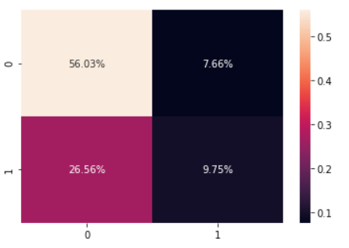
The confusion matrix obtained after applying logistic regression to the dataset:
Logistic Regression

Slide 9
Support Vector Machine
A Support Vector Machine is a discriminative classifier formally defined by a separating hyperplane. In other words, given labelled training data (supervised learning), the algorithm outputs an optimal hyperplane which categorizes new examples.
In a 2-dimensional space this hyperplane is a line dividing a plane in two parts with one class on each side of the line.
In a 3-dimensional space, this separator is instead a plane separating the different classes.
The Support Vector Machine attempts to find a separating hyperplane with a margin that is as large as possible from the nearest data points.

Slide 10
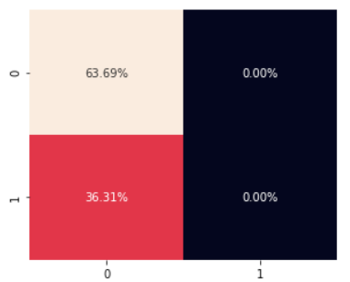
The confusion matrix obtained after applying SVM to the dataset:
Support Vector Machine

Slide 11
Decision Tree
Decision Tree algorithm belongs to the family of supervised learning algorithms. Unlike other supervised learning algorithms, the decision tree algorithm can be used for solving regression and classification problems too.
The goal of using a Decision Tree is to create a training model that can use to predict the class or value of the target variable by learning simple decision rules inferred from prior data(training data).
In Decision Trees, for predicting a class label for a record we start from the root of the tree. We compare the values of the root attribute with the record’s attribute. On the basis of comparison, we follow the branch corresponding to that value and jump to the next node.

Slide 12
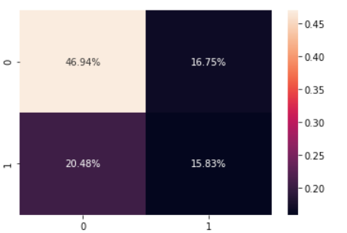
The confusion matrix obtained after applying Decision Tree to the dataset:
Decision Tree

Slide 13
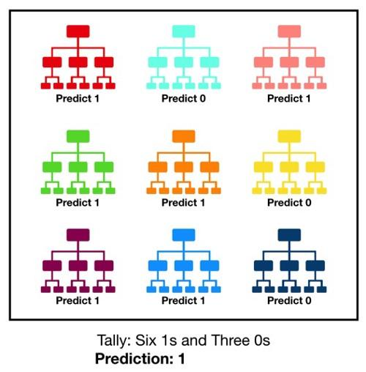
Random Forest
Random forest, like its name implies, consists of a large number of individual decision trees that operate as an ensemble. Each individual tree in the random forest spits out a class prediction and the class with the most votes becomes our model’s prediction.

Slide 14
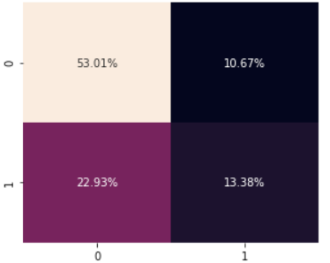
The confusion matrix obtained after applying Random Forest to the dataset:
Random Forest

Slide 15
K-Nearest Neighbours
K-Nearest Neighbours classification implements learning based on the K nearest neighbours of each query point.
This method is a type of non-generalizing learning since it only stores instances of the training data, it does not create an internal model for generalizing the data. The classification is evaluated from a majority vote of the nearest neighbours of each query point, and each point is assigned to the class which is the most common among its neighbours.
The choice of the value of k is dependent on the dataset: if k is set to a low value, the point is assigned to a class with only a few neighbours, and if k is a high value, then the effect of noise is suppressed and the classification is of a more general form.

Slide 16
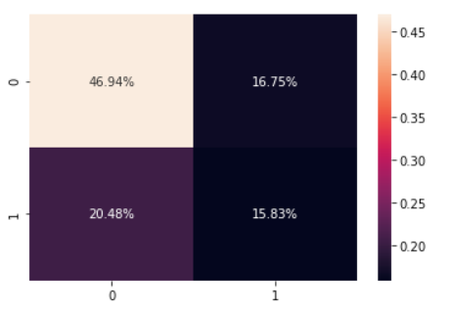
The confusion matrix obtained after applying K Nearest Neighbours Model to the dataset:
K Nearest Neighbours

Slide 17
Neural Networks:
Neural Networks are the biomimicry of human brain. Neural networks are multi-layer networks of neurons that we use to classify things, make predictions, etc. They are inspired by biological neural networks and the current so-called deep neural networks have proven to work quite well.
The idea of ANNs is based on the belief that working of human brain by making the right connections, can be imitated using silicon and wires as living neurons and dendrites.
ANNs are composed of multiple nodes, which imitate biological neurons of human brain. The neurons are connected by links and they interact with each other. The nodes can take input data and perform simple operations on the data. The result of these operations is passed to other neurons. The output at each node is called its activation or node value.

Slide 18
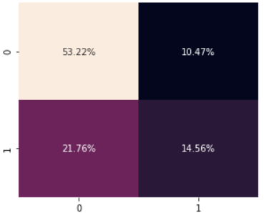
The confusion matrix obtained after applying Artificial Neural Networks to the dataset:
Artificial Neural Networks

Slide 19
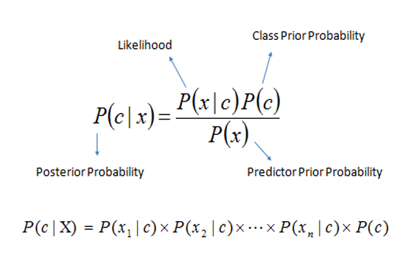
Naive Bayes
This is a classification technique based on an assumption of independence between predictors or what’s known as Bayes’ theorem. In simple terms, a Naïve Bayes assumes that the presence of a particular feature in a class is unrelated to the presence of any other feature. Bayes theorem provides a way of calculating posterior probability P(c|x) from P(c), P(x) and P(x|c). The expression for Posterior Probability is as follows.

Slide 20
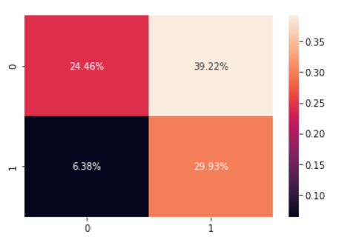
The confusion matrix obtained after applying Naive Bayes to the dataset:
Naive Bayes

Slide 21
Results:
We have implemented different machine learning models and predicted whether a song will be a Billboard Hot 100 hit or not. We have gotten following results:
Algorithm | Accuracy
Logistic Regression | 65.83%
Naive Bayes | 53.19%
K Nearest Neighbours | 62.96%
Decision Tree | 62.70%
Random Forest | 67.28%
Support Vector Machine | 63.95%
Artificial Neural Network | 70.08%

Slide 22
The following insights are gained from the above results:
While the Logistic Regression Models gives many false negative, the Naïve Bayes gives many false positives.
Artificial Neural Network gives the best accuracy of 70%. It has 2 hidden layers.
SVM fails to identify the positive class completely and has not performed well.

Slide 23
Conclusion and future Work:
The Billboard Hot 100 chart is one of the definitive ways to measure the success of a popular song.
This project is relevant to musicians and music labels. Not only will it help determine how best to produce songs to maximize their potential for becoming a hit, it could also help decide which songs could give the greatest return for investment on advertising and publicity. Furthermore, it would help artists and music labels determine which songs are unlikely to become Billboard Hot 100 hits.
This will help musicians to review their work and improve the quality of song. In this synopsis, we have introduced a machine learning based model for predicting hit songs based on audio features, artist, genre. This project will also help the music labels to review songs.

Slide 24
References:
HITPREDICT: PREDICTING HIT SONGS USING SPOTIFY DATA STANFORD COMPUTER SCIENCE 229: MACHINE LEARNING by Elena Georgieva, Marcella Suta, and Nicholas Burton.
Predicting Hit Songs with Machine Learning" by Minna Reiman and Philippa Ornell.
Hit song is not yet a science” by Pachet and Roy.
www.towardsdatascience.com
www.medium.com
Spotipy python documentation: https://spotipy.readthedocs.io/en/2.13.0/
Predicting Hit Songs with Machine Learning by MINNA REIMAN PHILIPPA ÖRNELL
https://scikit-learn.org/stable/ Scikit learn documentation Python

Slide 25
Thank You

